Slide 1
FUNDAMENTALS OF POWDER CHARGING
BY MITSUBA SYSTEMS
INDIA
An ISO 9001:2000 Certified Company

Slide 2
Q-Why you need a gun?

Slide 3
A-To charge the powder.

Slide 4
Q-Why you need to charge the powder?

Slide 5
A-To deposit the powder on the object till it reaches in the oven.

Slide 6
Q-How many way one can charge the powder?

Slide 7
A-Two ways - a) External (Corona)
b) Internal (Tribo)

Slide 8
Q-Can you explain one by one?

Slide 9
A-External charging (Corona) – When 100KV is release at the gun tip (corona discharge) it breaks the air between gun tip and object. It breaks the air gap (known as ionization). in millions of ions of both the polarity. I.e. –-ve and +ve.

Slide 10
A-The +ve ions will attract toward the gun tip as it is of –ve polarity (opposite charge attracts) and get earthed. The powder releasing from the gun will the collide with –ve ions in the field and will acquire –ve charge. The charged powder will move towards object, which is earthed. The powder is charge externally.
Mitsuba systems (India) Pvt Ltd.

Slide 11
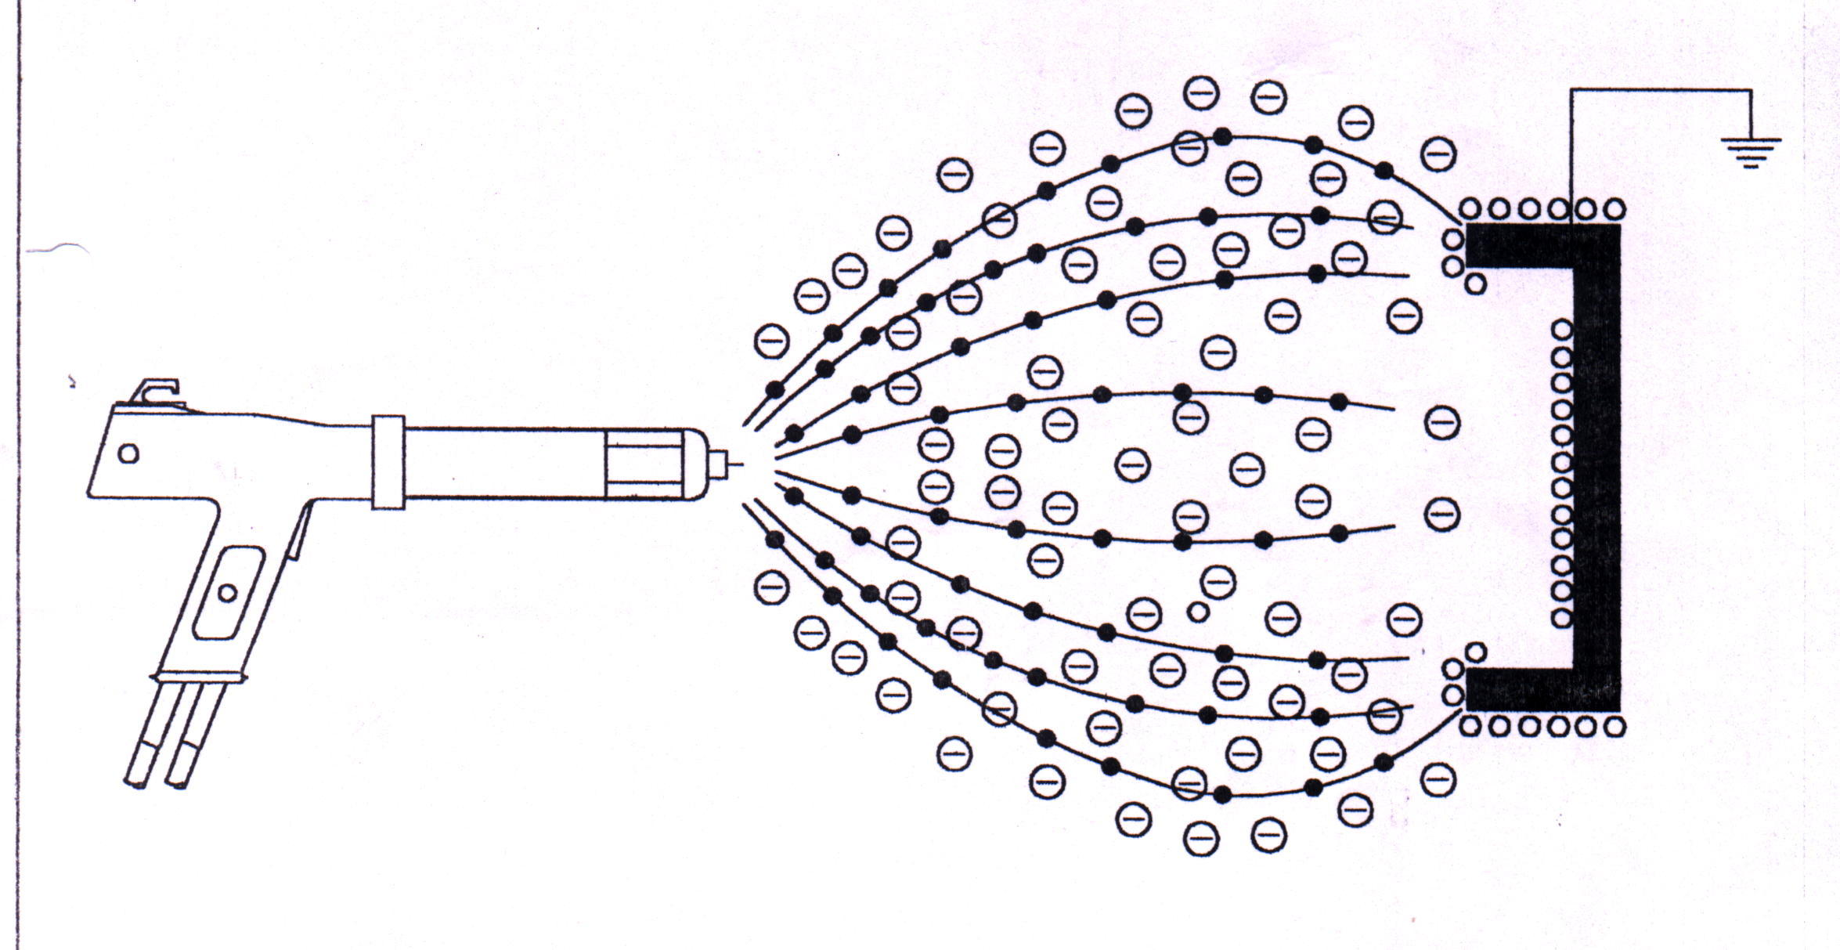

Slide 12
A-Internal charging (Tribo) – Tribo type gun powder is charged by friction. The powder moving in the gun gets rubbing action with the charge media and get charged.
As powder is charged in gun itself, it is known as internal charge.

Slide 13
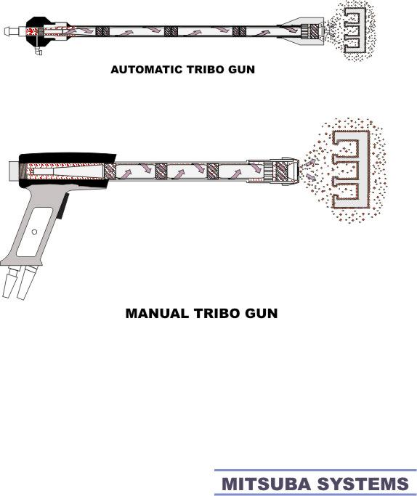

Slide 14
Q-Which gun i.e. corona or tribo is more prevalent, why?

Slide 15
A-Corona type is more prevalent. Being externally type can charge any type of powder. (I.e. epoxy, polyester, hybrid, metallic etc.)

Slide 16
A-Tribo charging is powder dependent i.e. certain powders like pure epoxy and pure polyester will charge the hybrid will not. So it has limited application. Beside powder dependent tribo guns require more maintenance and lower through put of powder.

Slide 17
A-Tribo has advantages also as there is no free ions in field; the finish is fine as compared to corona type.

Slide 18
Q-What does a good powder coating gun should give?

Slide 19
A-Higher coverage
Consistency in coating
  Convenience to operate and maintain

Slide 20
Q-How Mitsuba Systems gun offer all?

Slide 21
A-With guaranteed 100 KV generation coupled with range of nozzle and muzzle ensures higher coverage per KG of powder.
Stringent quality control, high standard of components and innovate design will give consistent in coating for time to come.

Slide 22
A-The coating job is very critical. The Mitsuba machine has all user friendly features like:
    Performance Monitor.
    Infinity corona re-settable cascade.
    IP 54 International standard dust proof panel.
    CE certified.
Mitsuba systems (India) Pvt Ltd.

Slide 23
Q-How does type of nozzle and muzzle effect transfer efficiency?

Slide 24
A-Nozzle sprays the powder. If over spray is less, efficiency will be higher. Appropriate nozzle can give highest F.P.T.E. and will reduce the overall coating cost.

Slide 25
Q-How many types of nozzle and muzzle are available? How and when they are used?

Slide 26
A-Round spray muzzle and flat spray muzzles are the most popular with the coaters.
Round Spray (i.e. four electrode) muzzle dispense the powder like showers. Ideal for flat surface. Due to lower speed, the ability to penetrate the corner is limited.

Slide 27
A-Flat spay muzzle is the most popular due to its extraordinary ability to penetrate the corners. It offers highest F.P.T.E. for even complicated job.

Slide 28
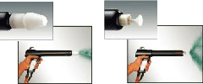

Slide 29
Q-What powder quality assurance tool your company offers?
Mitsuba systems (India) Pvt Ltd.

Slide 30
A- Brief Case
Efficiency Meter

Slide 31
A-It was brief presentation about powder charging, the company offers much more you can visit www.powdergun.com or call us for any other information.

Slide 32
Q-Why you need a powder recovery system?

Slide 33
A-The over spray powder need to recovery for reuse purpose. Recovery needs to connect the powder booth to recollect the maximum.

Slide 35
Q-How many type of recovery is available? What is advantage and disadvantage of booth?

Slide 36
A-Cyclone recovery: Cyclone recovery booth is the most popular among coater. Blower sucks the powder from the booth and powder will be introduced in cyclone separator tangentially.

Slide 37
A-The powder will settle in collector bin. Cyclone is the cheapest recovery. The collection efficiency is about 85% to 90%. Due to tangentially entry colour change takes much time.

Slide 39
A-Rotary recovery: Instead of tangential entry, rotary cyclone offers axial entry to the powder laded air. By offering axial entry the duct has totally eliminated with result in fast colour change.

Slide 40
A-Axial entry cyclone is provided with rotary wings which gives necessary spin to air to create cyclonic motion which ensure powder to settle in collection bin. The rotary cyclone offers 99% recovery with fast colour change.

Slide 43
A-Cartridge filter: The cartridge filter is special recovery. The filter is made of aluminium coated polyester. The blower will suck the powder. The powder will get on the outside of filter and clean air will be exhausted to the atmosphere.

Slide 44
A-The filter cartridge is provided with the cleaning system. The air will be blast inside of filter which will dislodge the powder accumulate on outside of the filter. The powder will be collected at powder collection bin. The cartridge recovery offers 100% powder recovery.

Slide 45
A-But not recommended for frequent colour change as every colour need dedicated cartridge bank which makes its uneconomical.

Slide 47
Q-What are the other critical factors for good powder coating?

Slide 48
A-Good quality air.
Excellent earthing.

Slide 49
For More Information do visit
www.powdergun.com
MITSUBA SYSTEMS(INDIA)PVT LTD
34/H,NEW LINK ROAD,ANDHERI(WEST)
MUMBAI,400053
INDIA
TELEPHONE-0091-22-66924151/52/53
FAX-0091-22-66924154
Email-mitsuba@powdergun.com

